Slide 2
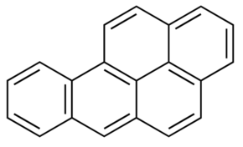
Benzo(a)pyrene (An Environmental Pollutant/Endocrine Disruptor)
Disrupts Ovarian Function: follicle development/ maturation & ovulation
Disrupts Testicular Function: spermatogenesis, sperm capacitation/acrosome reaction

