Slide 1
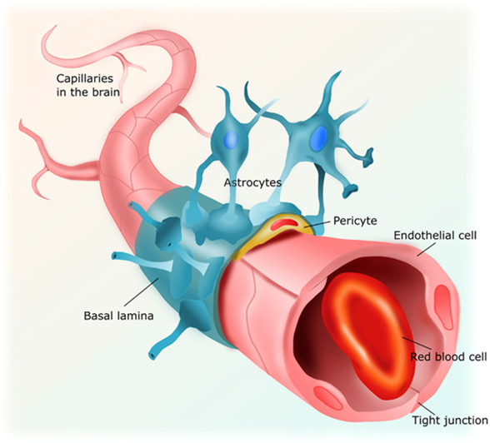
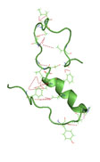
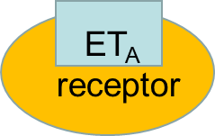
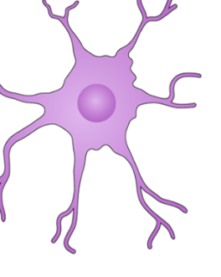
ET-1 Overexpression in brain capillaries: Implications for vasoconstriction and reduce cerebral blood flow
in AD and AD associated dementias
A-β
Astrocyte end feet
depolarization
Pericyte toxicity
Pericyte loss
ROS/ET-1
Dysr. Angiogenesis
Low CBF
Capillary constriction
VSMC
Neuronal toxicity
ET-1
ECE1/2
Basement membrane
dysfunction
Neuron
Neurodegeneration
AD/ADRD?

Slide 2
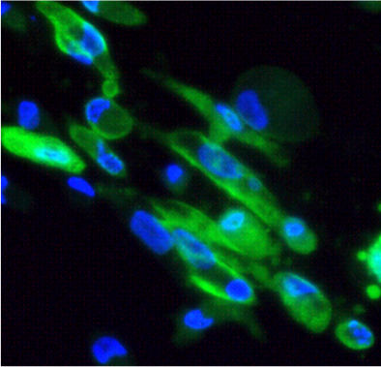
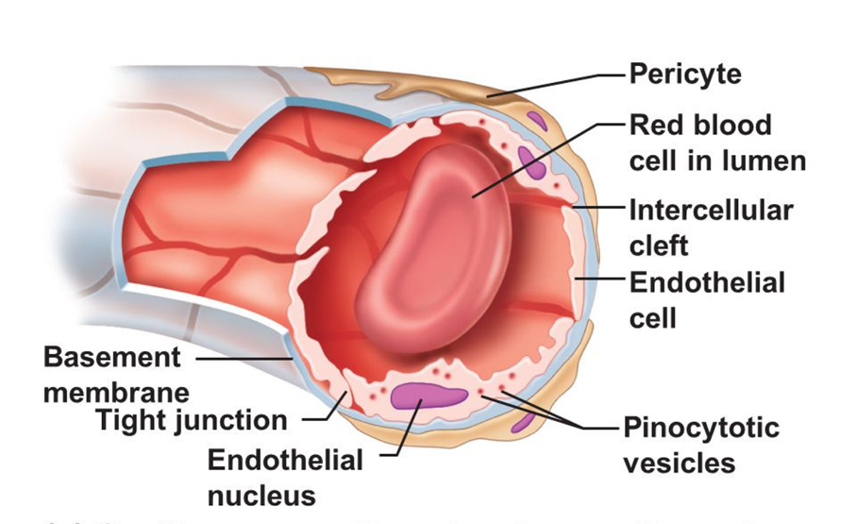
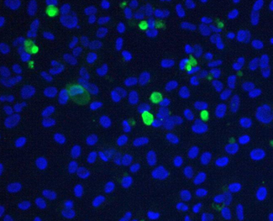
HCMV Infection of Human Vascular Pericytes
Brain pericytes
Lytic replication in Pericytes
Retinal pericytes
A.
B.
IFA 96h pp65
IFA 96h pp65
Renal mesangial cells/
kidney pericytes
Placental pericytes
C.
D.
Induction of
proinflammatory cytokine
IFA 96h pp65
IFA 96h pp65

