Slide 1


CAMPUS HIGHLIGHTS
NIH Grant Process
Anil Shanker, MS, PhD
Senior Vice President
for Research and Innovation

Slide 2
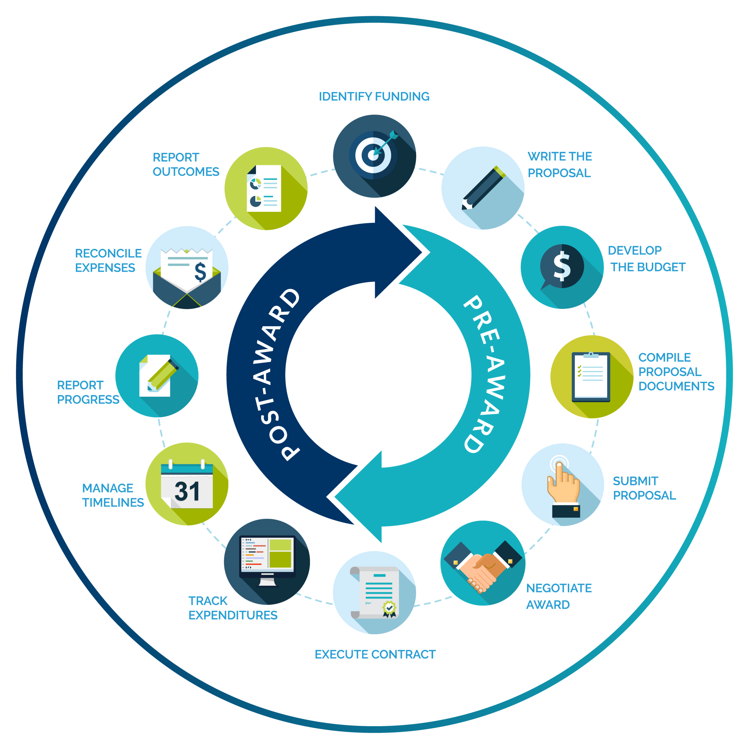

NIH Grant
Cycle

Slide 3
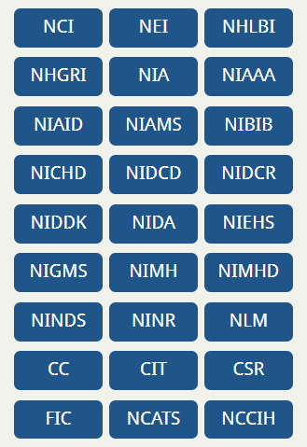
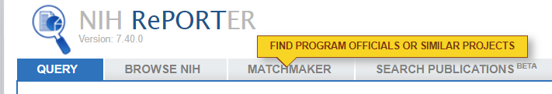
National Institutes of Health
~40 billion extramural funding is received through the 27 Institutes and Centers (ICs)
Each IC has its own
  mission,
  priorities,
  budget, and
  funding strategy
Matchmaker in NIH RePORTER helps us identify ICs with potential interest
Notes:
To answer this question, you need to know a bit about how the National Institutes of Health is structured. NIH is made up of 27 different institutes and centers (or ICs) of which 24 offer funding opportunities and award grants. This is a very important point. NIH funding is made through these institutes and centers.
Each IC has its own mission, priorities, budget, and funding strategy which are stated on each IC’s website.
The vast majority of grant processes and polices apply across NIH. That said, you will find some variability from one IC to the next. .
Do your homework. Identify which ICs might be interested in your area of science. Determine if your proposal fits within that ICs mission and priorities. Find out what has already been funded? By law, NIH can’t support a project already funded or pay for research that’s already been done.
You need to know and be able to articulate what sets your proposal apart.
In 2019 our overall success rate for competing research grants was around 20%. This is a highly competitive process.

Slide 4
NIH Funding Opportunities
Funding Opportunity Announcements (FOAs)
  Requests for Applications (RFA), Parent Announcements, Program announcements (PAs), Notices of Special Interest (NOSIs)
    Research Grants (R series)
    Career Development Awards (K series)
    Research Training and Fellowships (T & F)
    Program Project/Center Grants (P series)
    Resource Grants
Posted: NIH Guide and Grants.gov; circulated to campus bi-weekly by the OfRI Grants Management Office

Slide 5



Each NIH Funding Opportunity Has Its Program Team
Program Official
(PO)
Scientific Review
Officer (SRO)
Grants Management
Officer (GMO)

Slide 6
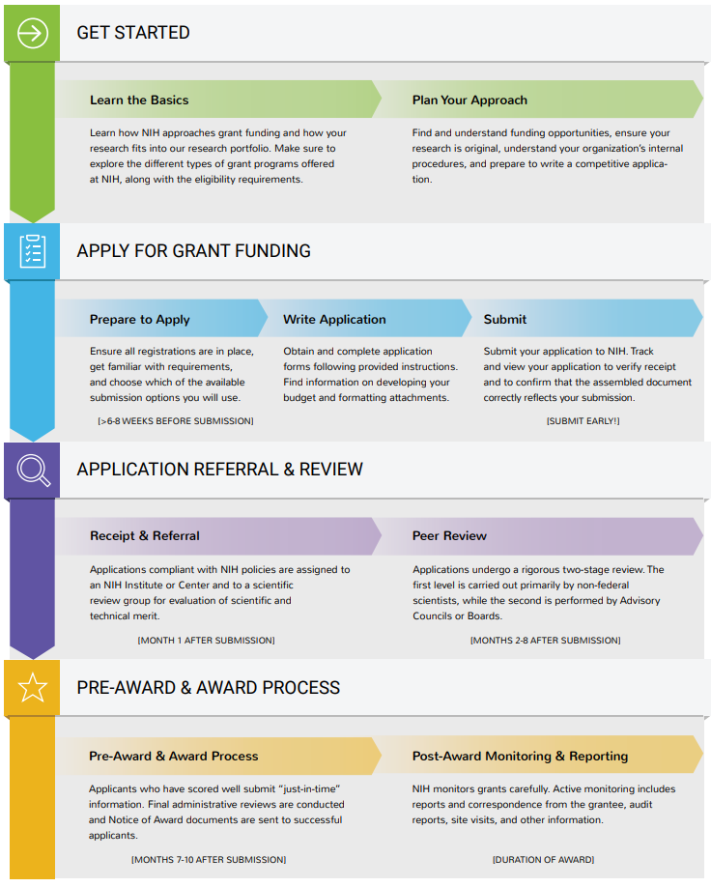
Key Steps in NIH Grant Process

Slide 7
Grant application process
Planning (6+ months)
  Develop an original idea, preliminary data, a hypothesis, specific aims and a winning approach
  Build an appropriate team
  OfRI helps to build transdisciplinary teams, Reaches out to NIH PO

Slide 8
Prepare to apply
  PI notifies the GMO of the intent to submit (6+ weeks)
  GMO initiates a new application on one of the submission portals
  e-RA Commons registrations for all key personnel
Finalize application and budget
  Follow FOA instructions and review criteria
Submission
  All Federal Grants require submission by the Institutional Officer (AOR; Shanker) or his designee (Ballard)
  GMO submits once all certifications and assurances are completed by the applicant PI
Notes:
When writing your application you must follow application guide, FOA-specific and any relevant guidance in NIH Guide notices. And be sure to address the FOA review criteria in your proposals.
Any, you’ll submit days ahead of the due date to make sure you have time to address any unforeseen issues.

Slide 9
Receipt & referral at the NIH CSR
Peer review: scientific & technical merit
NIH Advisory Council – funding recommendations
IC Director – final funding decisions
Factor 1: Importance of the Research
(Significance, Innovation), scored 1-9
Factor 2: Rigor and Feasibility
(Approach), scored 1-9
Factor 3: Expertise and Resources
(Investigator, Environment)
    Appropriate
    Inappropriate: Identify the need for additional expertise and/or resources
Notes:
About 2 weeks after you submit, your referral and review assignment will be available in eRA Commons status.
The peer review meeting will take place on the day indicated in eRA Commons. Two-three days after the meeting, the priority score & percentile information will be added to the status And the summary statement will follow about 1 month after review.

Slide 10
Pre-award & award issuance
  Site visits
  Key Personnel “Just-in-time information”
  Regulatory review (IRB, IACUC)
  NoA – ~9 months
Post-award monitoring & reporting
  Duration of award
    Project and financial reports
    Audits and site visits for the continuation of awards
  Final Reports and Close-out
Notes:
If selected for funding you’ll receive the notice of award which will be approximately 9 months after your application due date.
Post-award monitoring and reporting are carried out through the duration of the award.

Slide 11
Thank you for your attention!
Questions?

